Slide 1
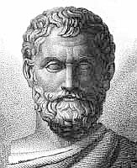
THE IONICS
PHILOSOPHY OF THALES
(624 B.C.- 550BC.)

Slide 2
Ionics school
The earliest Greek philosophers belong to what in after times came to be called the Ionic School.
The name was derived from the fact that the three chief representatives of this school….

Slide 3
First: Thales 624 B.C. – 550 B.C.

Slide 4
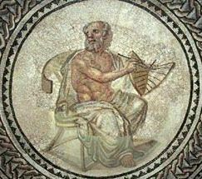
Second: Anaximander (610-547 BC)

Slide 5
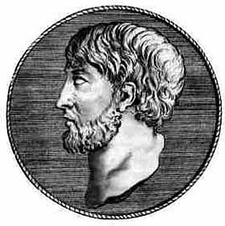
Last: Anaximenes (585-525 BC)

Slide 6
Thales
Thales of Miletus is generally accounted the founder and father of all philosophy.
He was born about 624 B.C. and died about 550 B.C.
These dates are approximate.
He was a contemporary of Solon and Croesus.

Slide 7
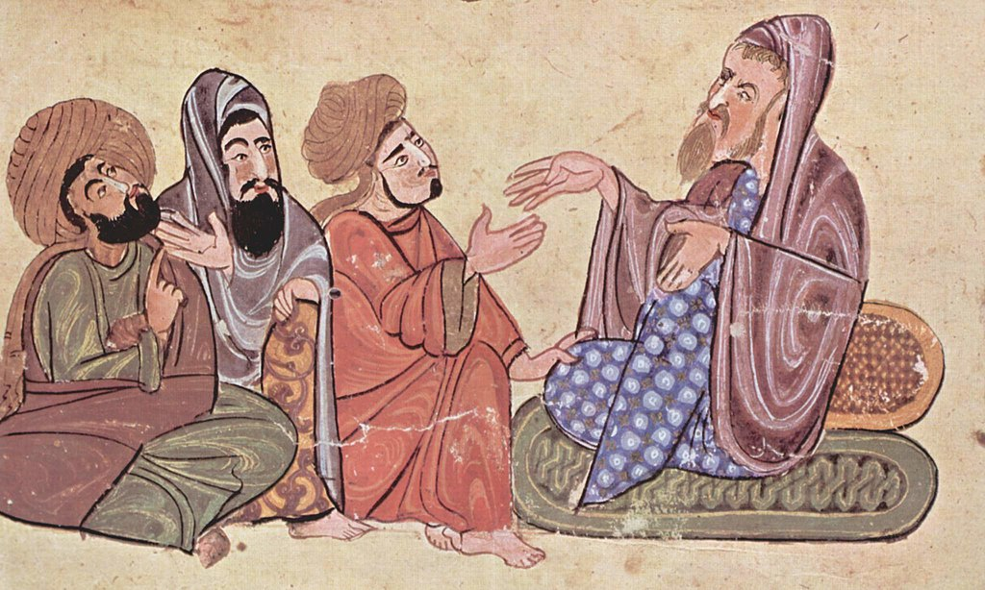
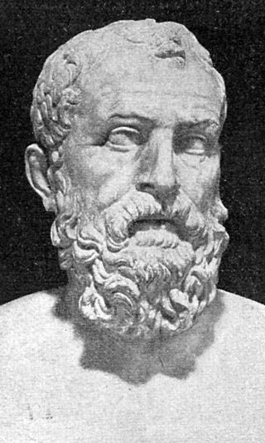
Solon (638 BC- 558 BC)
Solon was an Athenian statesman,
lawmaker and poet.
He is remembered particularly for his efforts to legislate against political, economic and moral decline in archaic Athens.

Slide 8
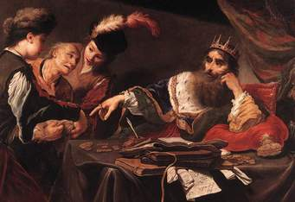
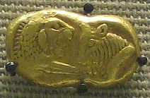
Croesus (595 BC – c. 546 BC)
Croesus was the king of Lydia who, according to Herodotus, reigned for 14 years: from 560 BC until his defeat by the Persian king Cyrus the Great in 546 BC (sometimes given as 547 BC).
Gold coin of Croesus, Lydian, around 550 BC, from modern Turkey.

Slide 9
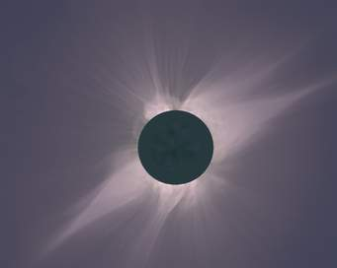
Thales’s wisdom
He was famous in antiquity for his mathematical and astronomical learning.
An eclipse of the sun occurred in 585 B.C. and Thales is alleged to have predicted it.

Slide 10
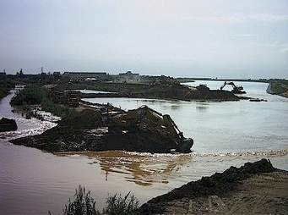
Great engineer
He caused a diversion of the river Halys, when Croesus and his army were unable to cross it.

Slide 11
Philosophical thought
Firstly, that the principle of all things is water, that all comes from water, and to water all return.
Secondly, that the earth is a flat disc which floats upon water.

Slide 12
Two Questions
Why did Thales choose water as the first principle?
And how was the universe formed out of water?

Slide 13
Most likely he never asked himself the question, and gave no explanation.

Slide 14
Significance of his philosophy
We may naturally ask why, on account of such a crude and undeveloped idea, Thales should be given the title of the father of philosophy?

Slide 15
The significance of Thales is not that his water philosophy has any value in itself, but that this was the first recorded attempt to explain the universe on naturalistic and scientific principles, without the aid of myths and anthropomorphic gods.

Slide 16
The fundamental thought of that period was, that under the multiplicity of the world there must be a single ultimate principle.
Thus Thales asserted that the ultimate reality is water.

Slide 17
Ionic philosophers were all materialists.
They are also sometimes called Hylicists, from the Greek hule’ which means matter.

